Slide 1
Inflation
Meaning and measure of inflation
Actual vs constant dollar
Market and inflation free interest rates
Constant dollar and actual dollar analysis

Slide 2
Meaning of inflation
Inflation is the rate at which the general level of prices for goods and services rises over time, leading to a decrease in the purchasing power of money. In other words, as inflation increases, each unit of currency buys fewer goods and services than before. In simpler terms, it means that your money buys less today than it did yesterday.

Slide 3
Causes of Inflation:
  Demand-Pull Inflation: Occurs when demand for goods and services exceeds supply.
  Cost-Push Inflation: Happens when production costs (e.g., wages, raw materials) increase, leading to higher prices.
  Monetary Inflation: Results from an excessive increase in the money supply by central banks.

Slide 4
Measures of inflation
Measuring inflation is crucial for understanding the health of an economy and for policymakers to make informed decisions. Various indices are used, each capturing different aspects of price changes. Here are the most common measures of inflation:

Slide 5
Consumer Price Index (CPI)
  The CPI is the most widely recognized and used measure of inflation. It tracks the average change over time in the prices paid by urban consumers for a "basket" of consumer goods and services. This basket includes a wide range of items such as food, housing, transportation, medical care, clothing, and education.
  How it's calculated: Statistical agencies collect prices for thousands of items from various sources (retailers, service providers, etc.) at regular intervals (usually monthly). These prices are then weighted according to how much households typically spend on them. The inflation rate is the percentage change in the CPI over a specific period (e.g., month-over-month, year-over-year).
The Consumer Price Index (CPI) is like a "shopping basket tracker." It checks how much prices go up for everyday things (food, rent, gas, etc.) over time.

Slide 6
Producer Price Index (PPI)
The PPI measures the average change over time in the selling prices received by domestic producers for their output. Unlike the CPI, which focuses on prices paid by consumers, the PPI focuses on prices at the wholesale or producer level. It captures price changes from the seller's perspective.
  How it's calculated: Data is collected on prices of raw materials, intermediate goods, and finished goods as they leave the production stage.

Slide 7
3. Wholesale Price Index (WPI)
Measures the average change in prices of goods at the wholesale level (before reaching the consumer).
Focuses on raw materials and intermediate goods rather than retail prices.
Similar to the PPI, the WPI measures price changes at the wholesale level. It tracks the prices of goods traded in bulk between businesses, rather than goods directly bought by consumers.
It helps monitor price movements that reflect supply and demand in industry, manufacturing, and construction.

Slide 8
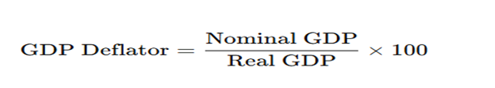
4. GDP Deflator (Gross Domestic Product Deflator)
The GDP deflator is a broader measure of inflation than the CPI or PPI. It measures the average change in the prices of all new, domestically produced, final goods and services in an economy.
How it's calculated: It's the ratio of nominal GDP (GDP at current prices) to real GDP (GDP at constant prices, adjusted for inflation), multiplied by 100.
Broadest measure of inflation that reflects price changes across all goods and services produced in an economy

Slide 9
Actual vs constant dollar
In economics and finance, when we talk about money over time, we need to consider the impact of inflation. This leads to the distinction between "actual dollars" and "constant dollars." They are also often referred to as "nominal dollars" and "real dollars," respectively.

Slide 10
Actual dollar
Definition: Actual dollars refer to the face value of money at the time it is earned, spent, or reported. It's the amount of money you actually have in your hand or that is recorded on a transaction slip.
What it includes: It includes any changes in price levels due to inflation or deflation. So, if a car cost RS10,00000 in 1990 and Rs 30,00000 in 2020, those are the actual dollar amounts for those years.
Actual dollars are useful for understanding the immediate value of transactions, current budgeting, and short-term financial planning. They reflect the current market prices.
If your salary in 2020 was 50,000 and your salary in 2025 is 60,000, these are your actual dollar earnings for those years.

Slide 11
Constant dollar
• Constant dollars are a way to measure money while removing the effect of inflation. Unlike actual dollars, which show the money you have at a specific time, constant dollars adjust past or present amounts to reflect the purchasing power of a chosen base year. This allows us to compare money across different years as if prices had stayed the same, making it easier to see the real growth or change in income, spending, or the economy, for example, if you earned 50,000 in 2000 and 70,000 in 2020, the actual dollars suggest your income increased. But after adjusting for inflation using constant dollars (e.g., in 2000 prices), your 2020 income might be equivalent to 55,000, showing the true increase in purchasing power rather than just the nominal amount.

Slide 12
Market and inflation free interest rates
Market free interest rate
The interest rate stated by banks and financial institutions for loan and saving accounts are called market interest rate. Generally, firms use market interest rate (inflation adjusted MARR) in evaluating their investment projects. It includes combine effect of earning value of capital and expected inflation or deflation.
The market interest rate (i), also called the nominal interest rate, is the interest rate observed in the market that includes the effect of inflation. It is used to evaluate cash flows in actual dollars (A$).
The market interest rate (i) is determined by combining the real interest rate (i′) and the inflation rate (f) 1+i=(1+i′)(1+f)

Slide 13
Inflation free interest rate/Real or constant dollar interest rate
It is the rate in which the inflation effects have been removed. It is known real interest rate and it can be computed when the market interest rate and inflation rate are given. In the absence of inflation, the market interest rate is same as the inflation free interest rate.
Inflation free interest rate I’= market interest – inflation rate (f)

Slide 14
Some numerical question
Example:1, The annual fuel cost required to operate a small solid waste treatment plant are projected to be Rs 200000 without considering any future inflation. The best estimate indicates that the annual inflation free interest rate I’ will be 6% and the general inflation rate f will be 5%. If the plant has the remaining useful life of four years, what is the present equivalent of its fuel costs? Use actual dollar analysis.
Solution
Inflation free rate of interest(I’)=6%
Inflation rate(f) = 5%
Year | Cash flow of fuel | Conversion factor (f)=5% | Actual cash flow
1 | 200000 | (1.05)¹ | 210000
2 | 200000 | (1.05)² | 220500
3 | 200000 | (1.05)³ | 231525
4 | 200000 | (1.05)⁴ | 243101

Slide 15
The market interest rate will be
1+i=(1+i′)(1+f)
i= (1.06x1.05)-1
=11.3%
The present equivalent cost will be,
Pw of actual cost (11.3)= 210000/1.113¹+220500/1.113²+231525/1.113³+243101/1.113⁴=693020

Slide 16
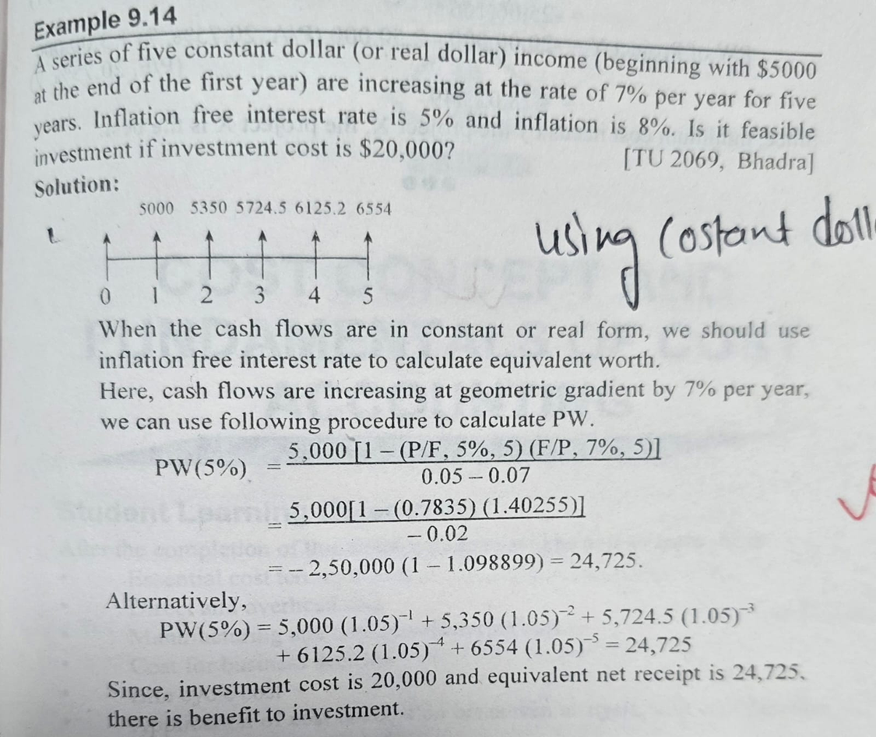

Slide 17
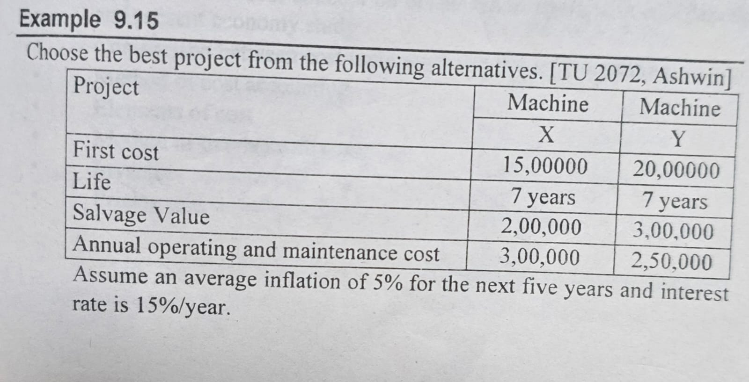

Slide 18
